Slide 2




BASAG
YELO

Slide 3


Wazz-APP?!

Slide 4


_ _ _ _ _ _ _ _

Slide 5
Snapchat

Slide 6
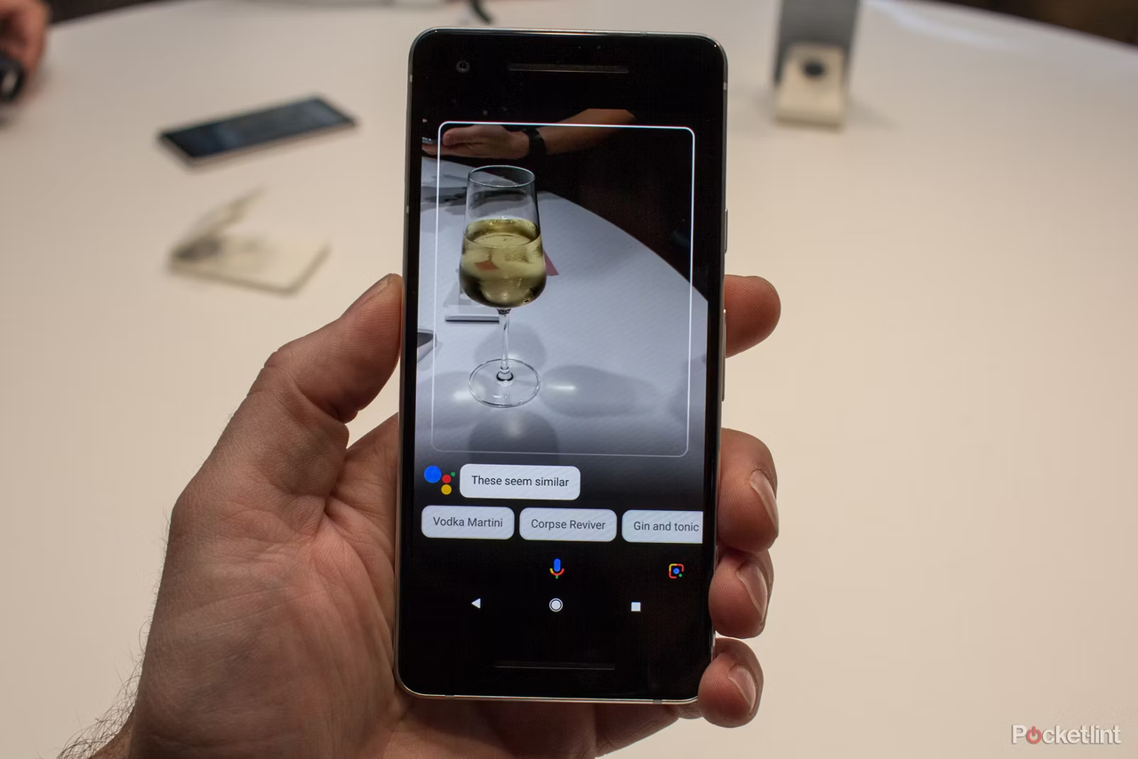

_ _ _ _ _ _ _ _ _

Slide 7
Google Lens

Slide 8


_ _ _ _ _ _

Slide 9
TikTok

Slide 10

_ _ _ _ _ _ _ _ _

Slide 11
Pokémon Go _ _ _ _ _ _

Slide 12
AUGMENTED
REALITY

Slide 13


CONTENTS
Introduction to Augmented Reality
AR Technologies and Devices
Core Concepts and Technique
Augmented Reality in Various Industries
Challenges and Future Directions
Examples and Success Stories

Slide 14

INTRODUCTION

Slide 15


Slide 16
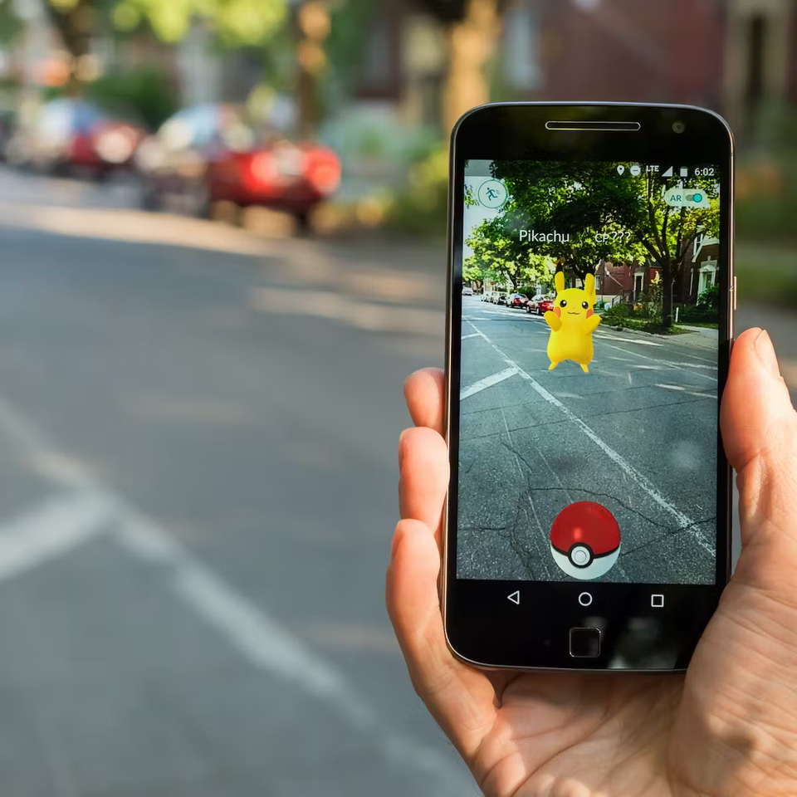
What really is
Augmented Reality?
In the context of Augmented Reality (AR), the term refers to a technology that combines virtual elements with the real-world environment to create an interactive and enhanced user experience. AR overlays computer-generated information, such as images, videos, or 3D models, onto the real world, allowing users to perceive and interact with both the physical and digital realms simultaneously.
LEARN MORE
Notes:
Pinagsama ung virtual element sa real world environment
Overlay/Nakapatong
pwedeng picture siya, video, 3d model.
interactable siya sa device nga lang

Slide 17
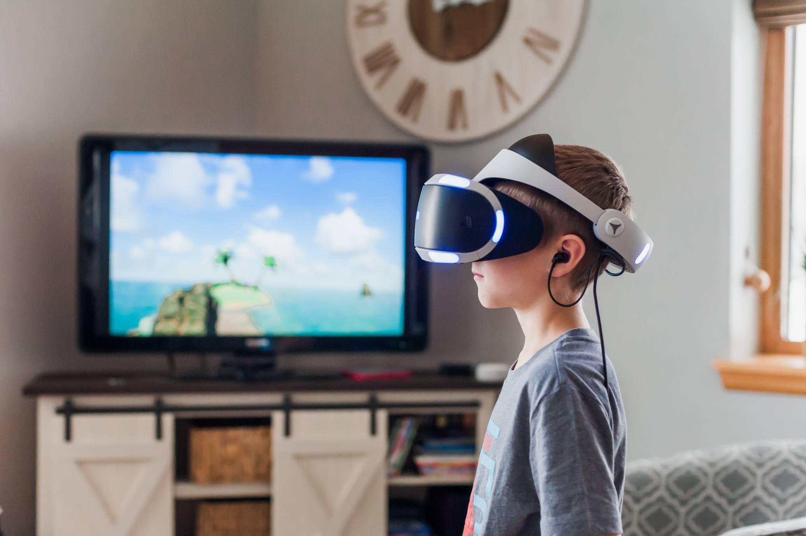
How it differs form
Virtual Reality?
Unlike Virtual Reality (VR), which immerses users in a completely simulated environment, AR enhances the real world by supplementing it with digital content. This technology achieves its effects through the use of various display devices, such as headsets, smart glasses, or mobile devices, which render the virtual elements and present them in a way that integrates seamlessly with the user's surroundings.
LEARN MORE
Notes:
ung virtual reality simulated ung world environment mismo as in walang halong reality environment o totoong
syempre alam natin na kailangang ng devices neto tulad ng.... (examples) para madisplay ung mga digital content o virtual elements nga sa totoong buhay

Slide 18
Augmented Reality
AR applications rely on advanced computer vision, image recognition, and sensor technologies to track the user's position and orientation in real-time, enabling the proper alignment and interaction between virtual and physical objects. This synchronization allows users to perceive the digital content as if it exists in the real world, enhancing their perception, understanding, and engagement with the environment.
LEARN MORE
Notes:
rely sa advanced computer vision, image recognition tsaka sensor techonologies
(markerbased/markerless)
correct placing ung mga virtual object sa physicial object sa real life
dahil nga synchronization ng mga to naperperceive o nakikita natin ung virtual element na un sa totoong buhay

Slide 19
Augmented Reality
AR has found applications across numerous industries, including gaming, entertainment, education, healthcare, retail, and more. Its potential lies in providing users with context-specific information, visualization of data, immersive storytelling, interactive training experiences, and enhanced decision-making support.
LEARN MORE
Notes:
AR na iintegrate na nga siya sa ibat ibang industries tulad ng examples at marami pang iba.
napakalaki nga ng potential ng ar dahil nga nag offer nga siya ng advantages sa users (examples) na magiging beneficial para sa kanila

Slide 20
Augmented Reality
Overall, AR merges the virtual and physical worlds, offering users a blended reality that augments their perception and interaction with their surroundings, unlocking new possibilities for communication, productivity, and entertainment.
LEARN MORE
Notes:
So again ung AR pinagsama ung virutal tsaka physical world gamit ung device na may AR capablities
nakikita nga ni user ung mga virutal elements na nakapatong sa physical world and nakakapag interact nga sila so dahil nga dito nag kakaroon ng (examples: possibilties for...)

Slide 21
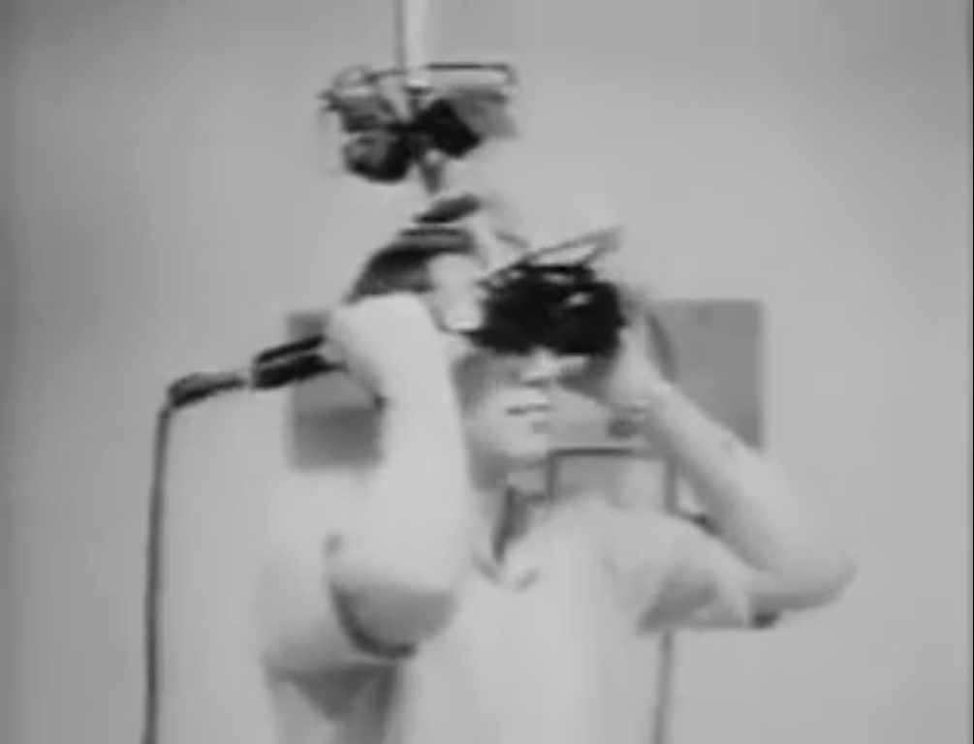

Brief History
Notes:
Dumaan naman tayo sa brief history ng AR

Slide 22

1968
Sword of Damocles
Computer Scientist Ivan Sutherland created the first AR head-mounted display system.
2023 PRESENTATION
Notes:
sa University of Salt Lake City in the United States
wala pa talaga ung term na AR nun pero may nakadevelop na nga ng HMDs/head-mounted display system nung 1960's
The device was so heavy, it had to be suspended from the ceiling and the user strapped to the device in order to work properly
The hovering and imposing installation was also the reason, why the device’s name was inspired by Greek mythology – hovering above the users head just as the ‘Sword of Damocles’…

Slide 23
'Sword of Damocles'
2022 PRESENTATION

Slide 24


1990
The term 'AR' was born
Boeing researchers T. Caudell & D. Mizell invented a head-mounted display for aircraft construction called 'Augmented Reality'.
2023 PRESENTATION
Notes:
Boeing Computer Service researchers Tom Caudell and David Mizell sila ung nag coin sa term na Augmented Reality bali sila narin nag patent nun
instruction board para makagawa ng mga aircraft
outdated na kasi ung paggamit ng instruction board tsaka kailangan mo ng ibat ibang klase nun para makapagbuild

Slide 25
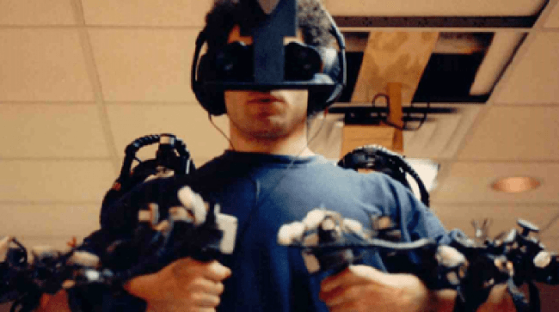
1992
Virtual Fixture
L. Rosenburg created the AR tool Virtual Fixtures' - a virtual flying training for Air Force pilots.
2023 PRESENTATION
Notes:
Louis Rosenburg created the AR tool ‘Virtual Fixtures’ at the US Air Force Research Laboratory, a virtual flying training for Air Force pilots. The system allowed military personnel to virtually control and guide machinery to perform tasks like training their US Air Force pilots on safer flying practices.

Slide 26

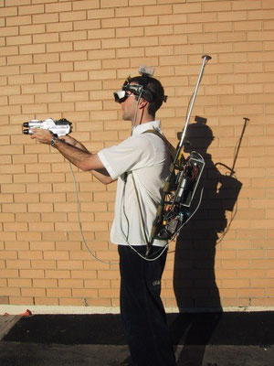
Late 1990s
ARToolKit and Wearable Computers
Hirokazu Kato develops ARToolKit & Steve Mann pioneers the concept of wearable computing
2023 PRESENTATION
Notes:
an open-source software library that enables the detection of markers and tracking of physical objects in real-time.
(computer vision, image recognition tsaka sensor techonologies)
(picture)
combining HMDs and portable computing devices to create a more mobile AR experience.

Slide 27
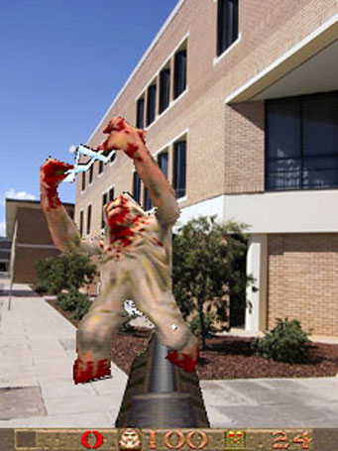
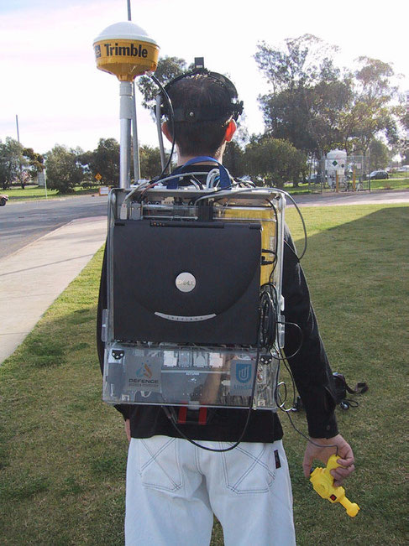
Early 2000s
Mobile AR and Gaming
ARQuake, an AR version of the game Quake, Mobile AR applications begin to emerge,
With the release of ARToolkitPlus and the ARhrrrr! game
2023 PRESENTATION
Notes:
is developed by Ron Azuma, demonstrating the potential of AR for gaming.
Head mounted display is Sony Glasstron (800x600 SVGA resolution).
System weight is 16 kg.

Slide 28
'AR Quake'
2022 PRESENTATION
Notes:
2000

Slide 29
'ARhrrrr'
2022 PRESENTATION
Notes:
2009

Slide 30
'AR Tennis'
2022 PRESENTATION
Notes:
2005

Slide 31


2010
Introduction of Mobile AR Platforms
Layar, one of the first mobile AR platforms, is released,
Qualcomm introduces the Vuforia platform
2023 PRESENTATION
Notes:
Layar: allowing developers to create AR experiences on smartphones.
Vuforia: offering computer vision capabilities for marker-based and markerless AR applications.
an augmented reality software development kit (SDK) for mobile devices that enables the creation of augmented reality applications. It uses computer vision technology to recognize and track planar images and 3D objects in real time.

Slide 32
'Layar App'
2022 PRESENTATION

Slide 33
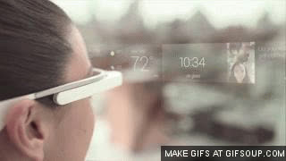
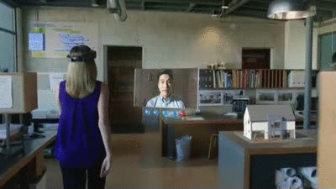
2013
Google Glass and HoloLens
Google unveils Google Glass
Microsoft announces the development of HoloLens
2023 PRESENTATION
Notes:
Google glass is a wearable AR device resembling eyeglasses, capable of displaying information in a hands-free manner.
Holo Lens is a head-mounted display that combines AR and virtual reality (VR) capabilities, allowing users to interact with virtual objects in the real world.
Apple Vision Pro

Slide 34
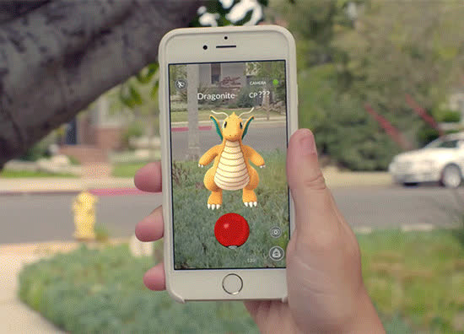

2016
Pokémon Go
Pokémon Go, a massively popular mobile AR game, is released.
2023 PRESENTATION
Notes:
demonstrating the mainstream potential of AR and its ability to blend digital content with the real world.

Slide 35

2017
ARKit and ARCore
Apple introduces ARKit.
Google releases ARCore,
2023 PRESENTATION
Notes:
ARKit: a framework for developing AR applications on iOS devices, enabling developers to create immersive AR experiences.
ARCore: a platform for building AR experiences on Android devices, expanding the reach of AR technology.

Slide 36

2020
Advancements in AR Hardware and Applications
Improved HMDs
AR applications find use in various industries.
2023 PRESENTATION
Notes:
such as the Magic Leap One and Microsoft HoloLens 2, offer more immersive and realistic AR experiences.
including healthcare, education, architecture, and retail, enhancing productivity and user experiences.

Slide 37
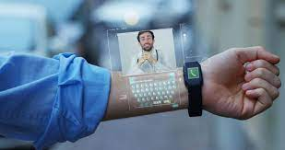
2020-Present
Present and Future Developments
AR technology continues to advance.
Integration of AR with 5G technology.
Augmented Reality glasses, contact lenses, and other wearable devices are being explored, aiming for lightweight, unobtrusive AR displays.
2023 PRESENTATION
Notes:
with ongoing research in areas like spatial mapping, gesture recognition, and real-time object tracking.
5g: promises enhanced connectivity and faster data transfer, enabling more complex and seamless AR experiences.

Slide 38
AR TECHNOLOGIES
and Devices

Slide 39
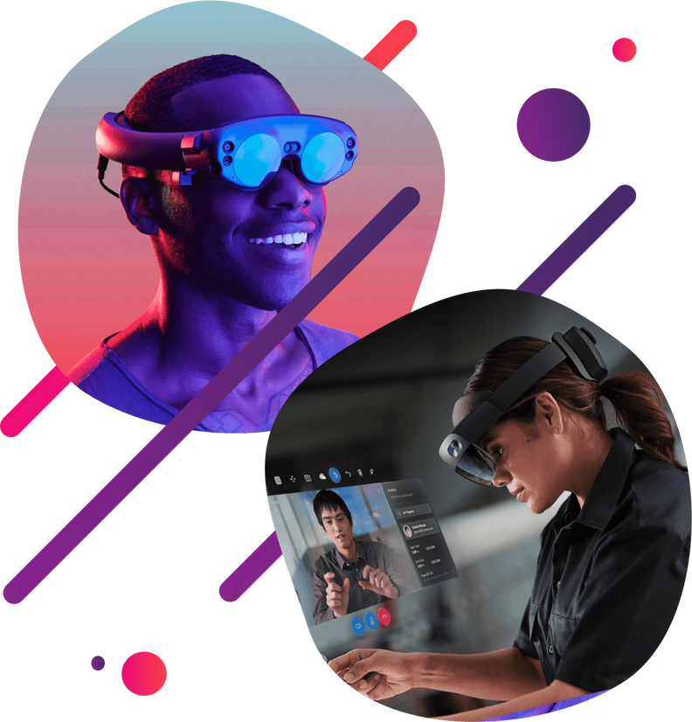
AR Technologies
and Devices
Augmented reality, or AR, is a technology that enhances interactive user experiences by fusing virtual and real-world aspects.
2023 PRESENTATION

Slide 40
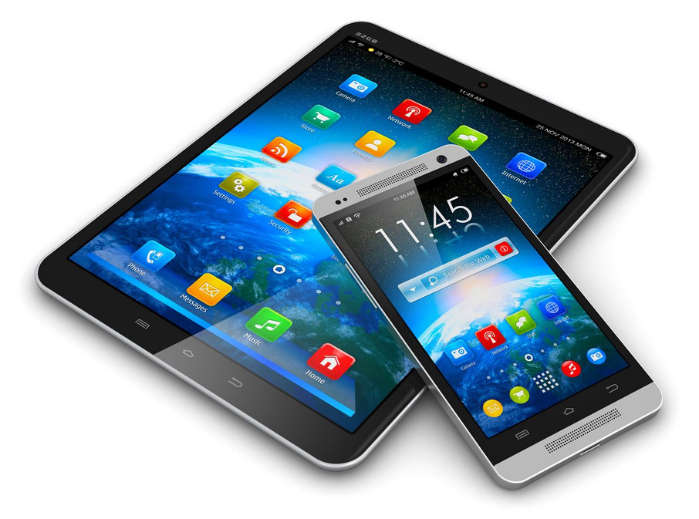
There are various AR technologies and devices available, each with its own unique features and applications.
1.) Smartphones and Tablets
The ability to use augmented reality is built into many current smartphones and tablets.
2022 PRESENTATION

Slide 41
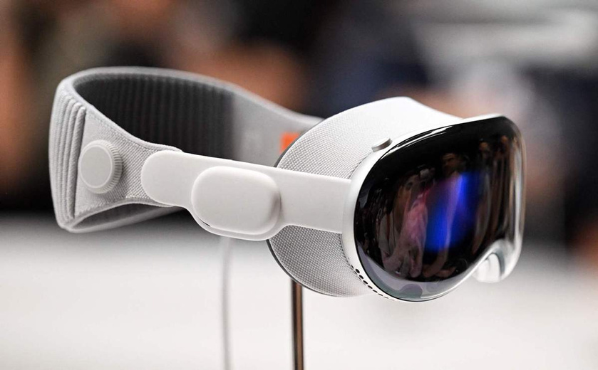
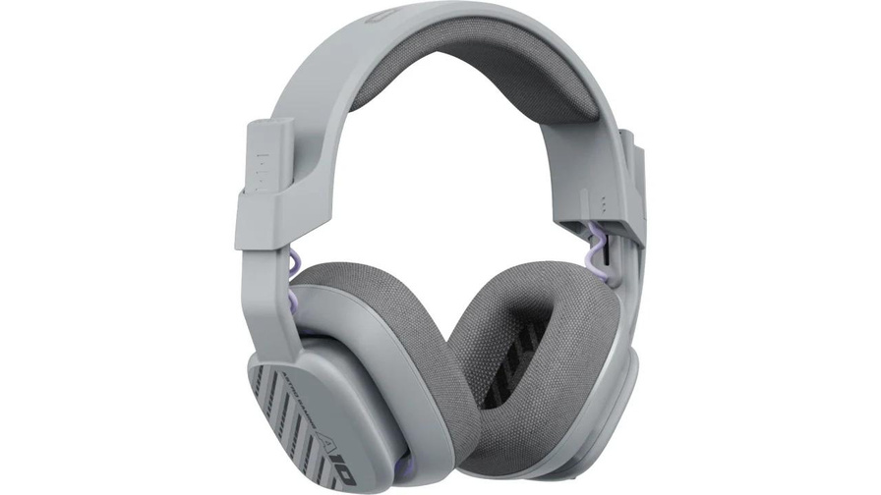
2.) AR Glasses
Smart glasses, commonly referred to as augmented reality (AR) glasses, are wearable gadgets that project virtual content into the user's field of vision.
3.) AR Headsets
AR headsets are like AR glasses but typically provide a more immersive experience.

Slide 42
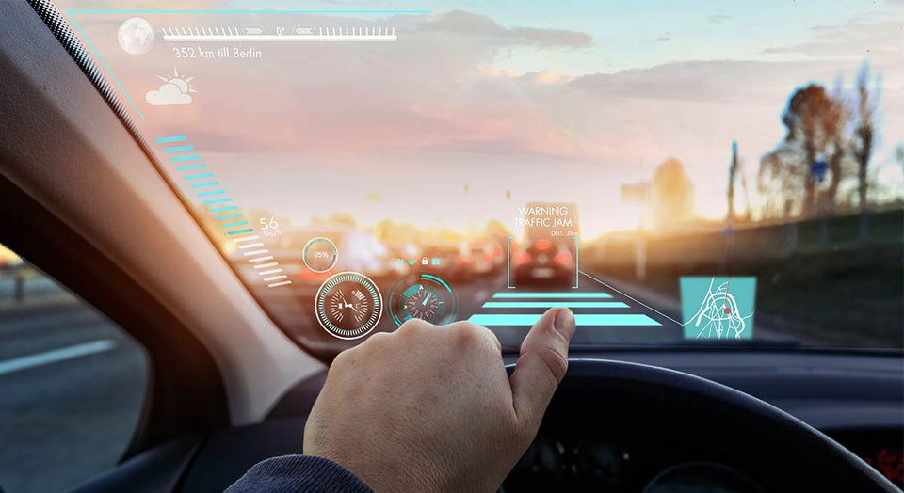
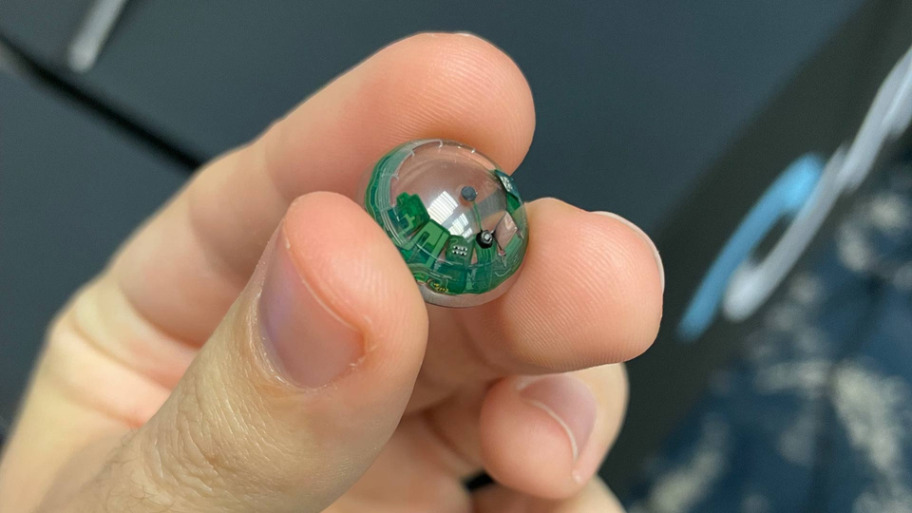
4.) HUDs (Heads-Up Displays
In order to give enhanced information without impeding the user's vision, HUDs are frequently employed in transportation, aviation, and athletics.
5.) AR Contact Lenses
While still in the early stages of development, AR contact lenses aim to provide a more natural and seamless AR experience.

Slide 43
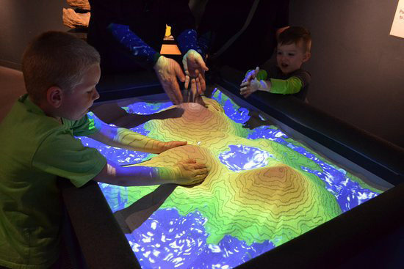
6.) Projection-based AR:
This approach involves projecting virtual content onto real-world surfaces

Slide 44
SOFTWARE
These platforms and tools give programmers the resources, libraries, and frameworks they need to create augmented reality apps. Here are a few that are frequently used:

Slide 45

1.) ARKit (iOS) and ARCore (Android):
For building AR applications for iOS devices, Apple offers the ARKit development framework.
Like this, Google's ARCore technology is used to create AR applications for Android smartphones.

Slide 46
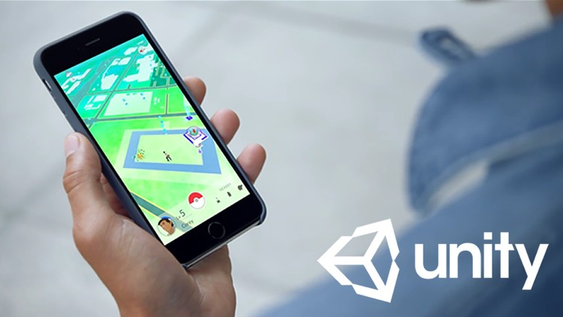
2.) Unity
It offers a comprehensive collection of features and tools made especially for building AR experiences. Developers may create AR applications for both iOS and Android using Unity's AR Foundation.

Slide 47


3.) Unreal Engine
Using the C++ programming language and Blueprint visual scripting framework, developers can build engaging AR experiences

Slide 48
4.) Vuforia
IT OFFERS RESOURCES FOR BOTH MARKER-BASED AND MARKER LESS AUGMENTED REALITY EXPERIENCES. THE OBJECT DETECTION, TRACKING, AND VIRTUAL CONTENT INSERTION CAPABILITIES OF VUFORIA ARE MADE POSSIBLE BY COMPUTER VISION ALGORITHMS.

Slide 49

5.) Wikitude
Wikitude enables both marker-based and marker less tracking.
IT INCLUDES A VARIETY OF FUNCTIONS, INCLUDING 3D MODEL RENDERING, GEOLOCATION-BASED AR, AND IMAGE RECOGNITION. TO CREATE AR APPLICATIONS FOR IOS, ANDROID, AND OTHER PLATFORMS, DEVELOPERS CAN USE WIKITUDE'S SDK.

Slide 50

6.) AR.js
An open-source JavaScript package called AR.js is used to build web-based AR experiences.
Without the need to download special apps, it exploits web technologies like WebGL and WebRTC to offer AR features right in the browser. Marker-based and location-based AR are supported by AR.js.

Slide 51


7.) Spark AR
Facebook developed the Spark AR platform, which focuses on developing augmented reality (AR) experiences for social media networks.
2022 PRESENTATION

Slide 52
TRACKING AND SENSORS
Various technologies are utilized to track user movements and the environment in order to enable AR interactions. Understanding the user's position, orientation, and surrounding environment is vital thanks to these technologies.

Slide 53
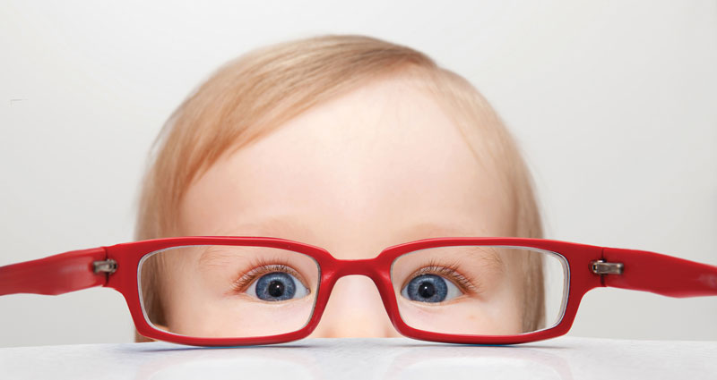
1.) Visual Tracking
Visual tracking involves following and analyzing the user's surroundings using cameras and computer vision techniques.
This can be accomplished using techniques like marker-based tracking and marker less tracking.

Slide 54
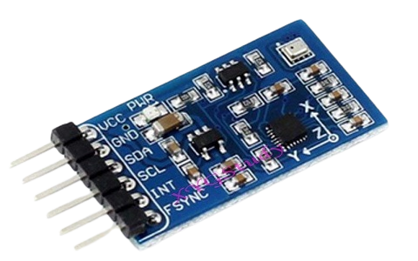
2.) Inertial Measurement Units (IMUs)
IMUs are motion sensors that frequently have magnetometers, accelerometers, and gyroscopes.
These sensors track the user's movements by measuring changes in velocity, rotation, and magnetic fields. In order to provide more precise and responsive tracking,

Slide 55
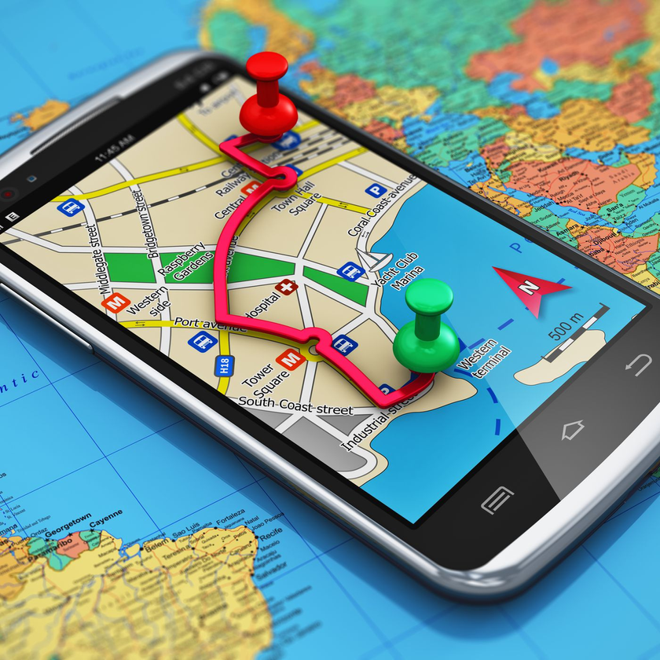
3.) Global Positioning System (GPS)
Satellites are used by GPS technology to determine the user's location.
Although GPS is frequently used for outdoor tracking, it has accuracy issues and is not appropriate for accurate AR interactions
2022 PRESENTATION

Slide 56
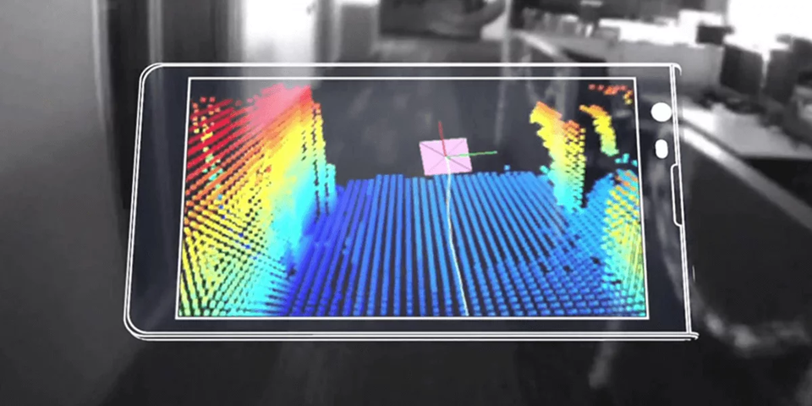
4.) Depth Sensing
Time-of-Flight (ToF) sensors and structured light systems are examples of depth sensing technologies that allow for the detection and measuring of distances to objects in the environment

Slide 57
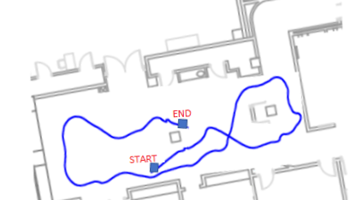
5.) SLAM (Simultaneous Localization and Mapping)
The goal of the SLAM technique is to simultaneously map the environment and track the user's position inside it by combining sensor data from cameras, IMUs, and other sensors.

Slide 58
6.) Beacon Based Tracking
Radio signals broadcast by Bluetooth Low Energy (BLE) beacons are used in beacon-based tracking to determine the user's location.
For indoor locating and tracking, beacons that have been put in the environment emit signals that a user's device can pick up.
2022 PRESENTATION

Slide 59
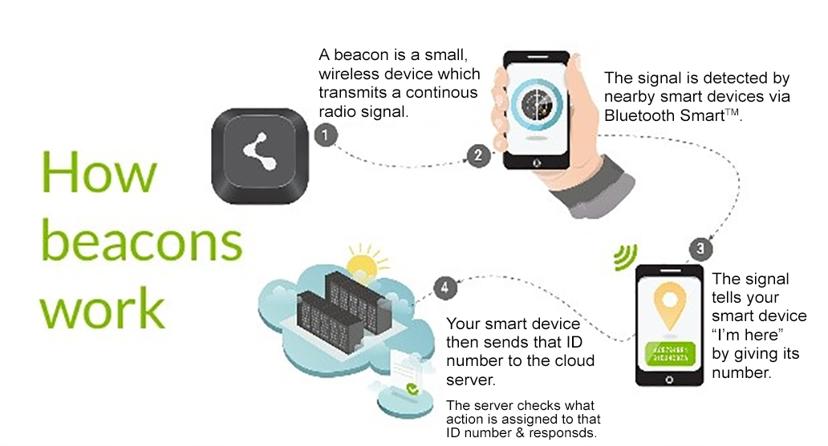
2022 PRESENTATION

Slide 60
CORE CONCEPTS & TECHNIQUES

Slide 61
Marker-based AR
Maker-based AR works by scanning a marker which triggers an augmented experience (whether an object, text, video or animation) to appear on the device. It usually requires software in the form of an app, which enables users to scan markers from their device using its camera feed.
LEARN MORE

Slide 62
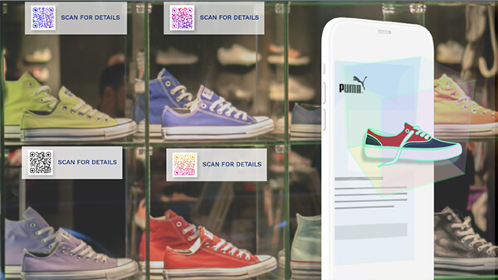
1. Marker-Based AR Example: Augmented Reality QR Code
LEARN MORE

Slide 63
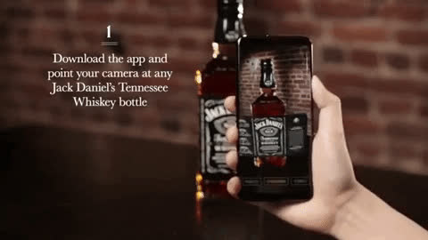
2. Marker-Based AR Example: Product Packaging
LEARN MORE

Slide 64
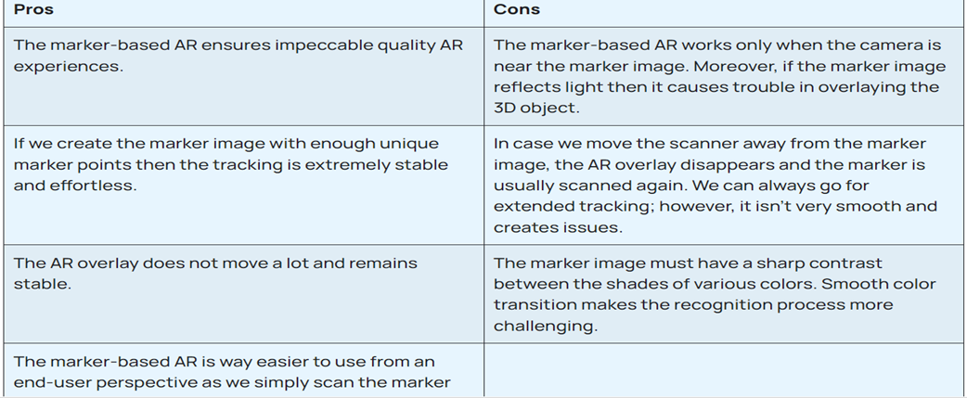
LEARN MORE

Slide 65
Markerless AR
Markerless Augmented Reality scans the real environment and places digital elements on a recognizable feature, like a flat surface. So, instead of being tied to a marker, the digital elements are placed based on geometry. Markerless Augmented Reality is very popular in gaming, like Pokémon Go, where characters can move around the environment. It is also often utilized for live events and virtual product placement
LEARN MORE

Slide 66
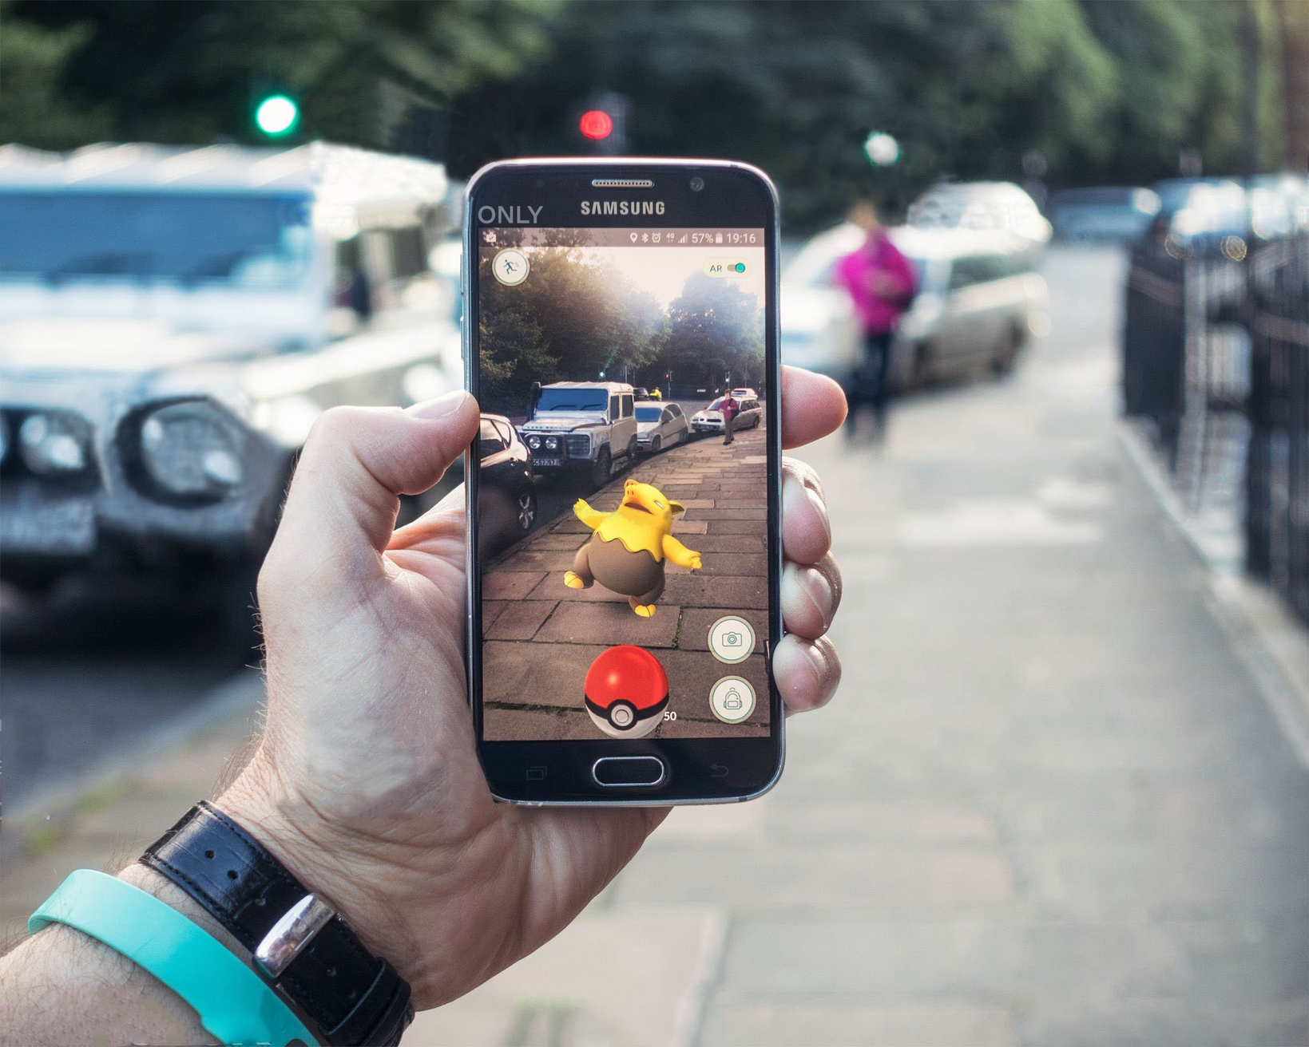
1. Markerless AR Example: Gaming (Pokémon Go)
LEARN MORE

Slide 67
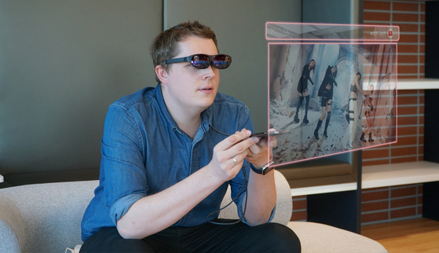
2. Markerless AR Example: Live Event
LEARN MORE

Slide 68
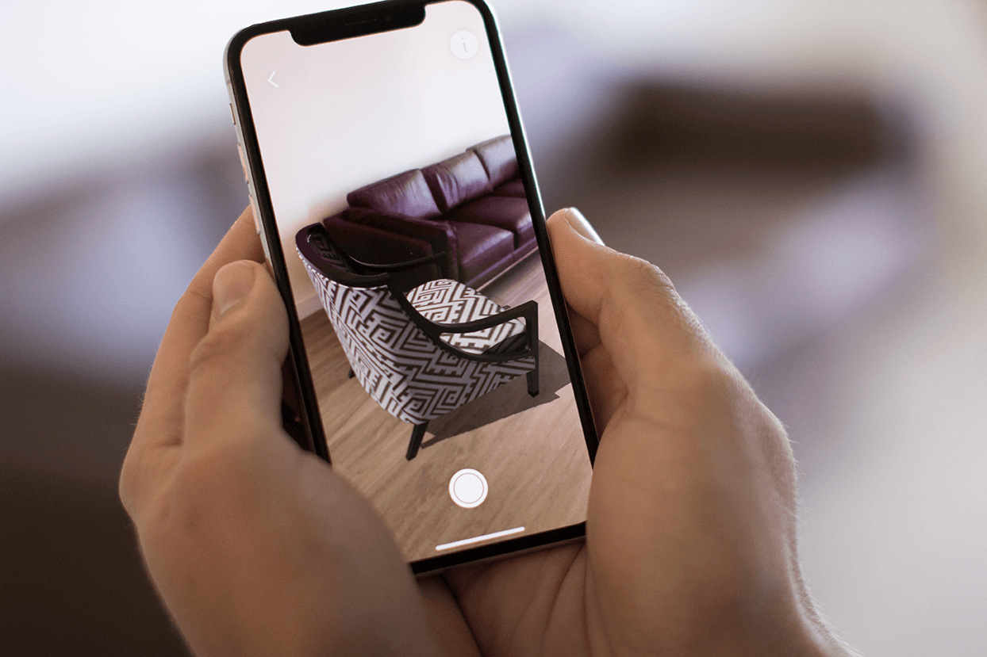
3. Markerless AR Example: Product Placement
LEARN MORE

Slide 69
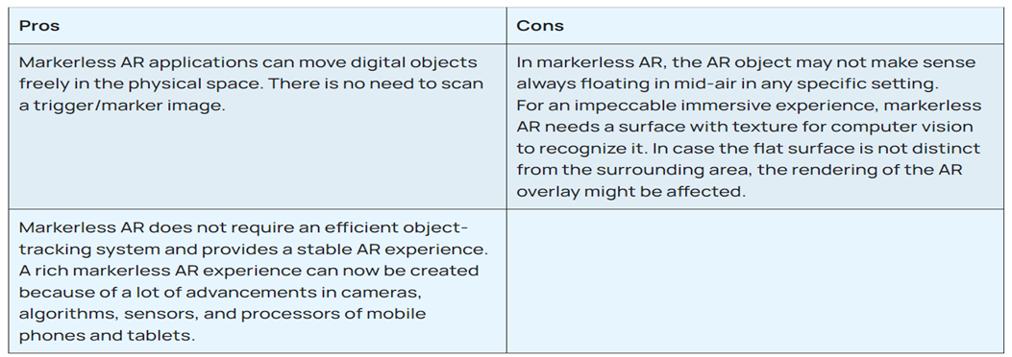
LEARN MORE

Slide 70
Location-based Augmented Reality
Location-based Augmented Reality (AR) is a type of AR experience that uses the user's real-world location as a foundation for the virtual content overlay. It involves integrating virtual elements into the user's surroundings based on their specific geographic location, offering a unique and contextually relevant AR experience.
LEARN MORE

Slide 71
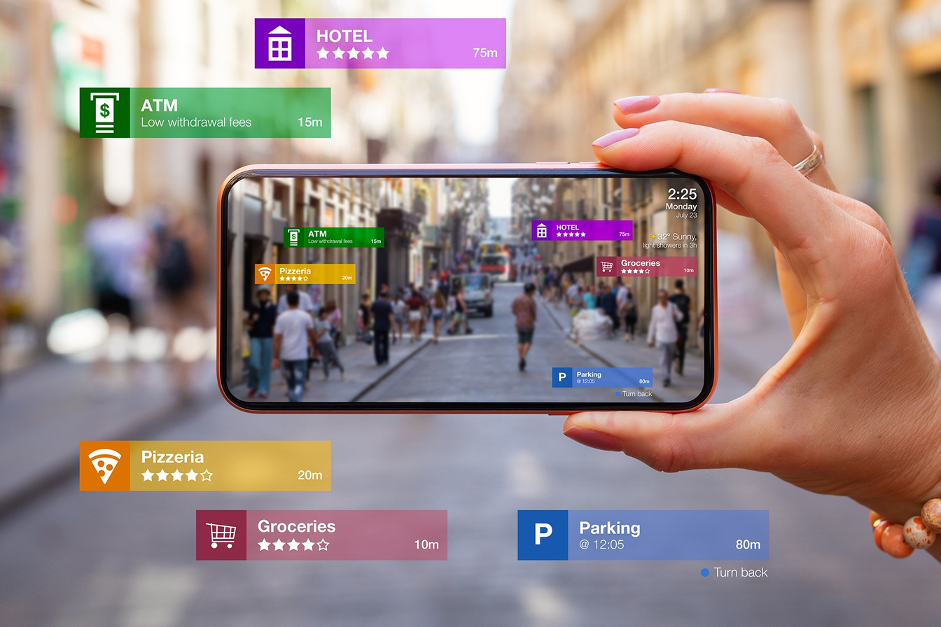
Location-Based AR Example: Directional Guidance
LEARN MORE

Slide 72
AR: object recognition
AR object recognition refers to the technology that enables augmented reality systems to identify and track real-world objects in order to overlay virtual content onto them. It involves using computer vision algorithms and machine learning techniques to recognize and understand objects based on their visual characteristics.
LEARN MORE

Slide 73
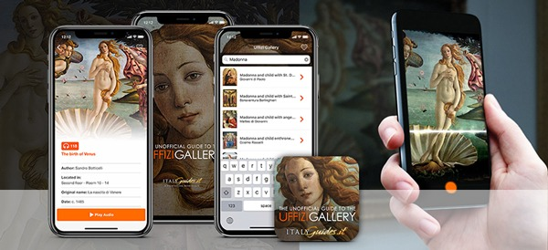
AR: object recognition
LEARN MORE

Slide 74
A.R. IN VARIOUS INDUSTRIES

Slide 75
A.R. in Various Industries
Industrial Augmented Reality (AR) is a technology that complements existing manufacturing processes and enables companies to improve efficiency and increase quality. AR enables companies to cut costs, reduce time to market, and build safer products.
LEARN MORE

Slide 76
A.R. in Various Industries
Five benefits of augmented reality in manufacturing
-Improving the quality of production processes.
-Reducing production and service costs in the field.
-Refining training and skills sharing.
-Improve industrial safety standards.
-Optimising the product assembly process.
LEARN MORE

Slide 77
12 EXAMPLES
OF AUGMENTED
REALITY IN
DIFFERENT
INDUSTRIES

Slide 78
. 1. Manufacturing
Augmented Reality manufacturing is an advanced form of automation that incorporates digital technology into the production line. It combines the physical world with computer-generated graphics, data, and interactive elements to create an enhanced reality.
It also promotes virtues like
-Cross-team collaboration
-Paperless workforce
-Simplified manufacturing workflows
LEARN MORE

Slide 79
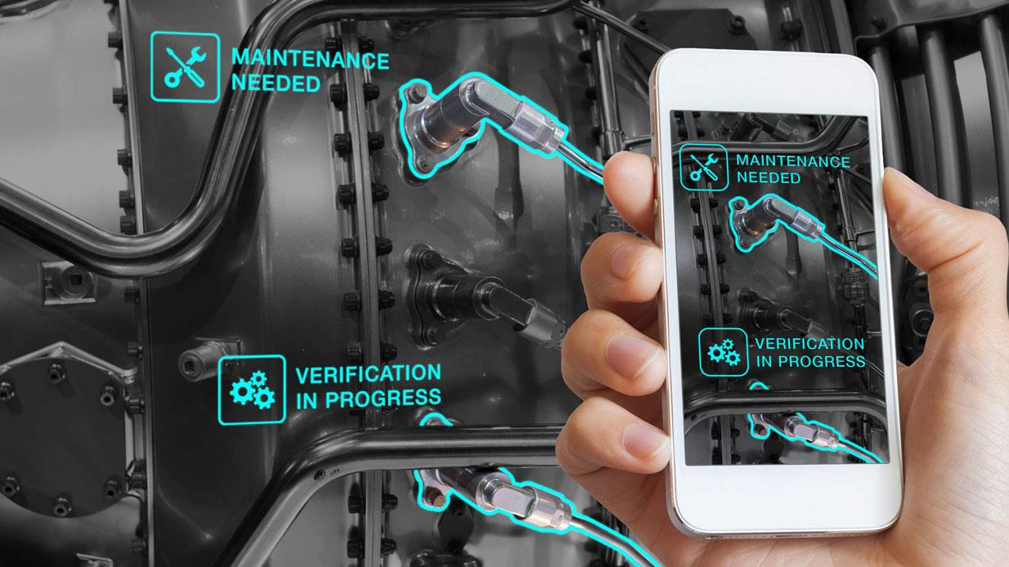
. 1. Manufacturing
LEARN MORE

Slide 80
2. Healthcare
Augmented Reality (AR) technology has the potential to transform various aspects of healthcare, ranging from medical training and education to patient care and surgical procedures.
LEARN MORE

Slide 81
It helps improve healthcare-delivery accuracy and supports safer healthcare services by allowing health professionals to:
-Work hands-free
-Access training videos
-Use images or annotated instructions
-Run quality assurance checklists
These healthcare professionals can also:
-Record and share voice communications
-Connect with coworkers through live video streams
-Collaborate and troubleshoot issues in real-time
LEARN MORE

Slide 82
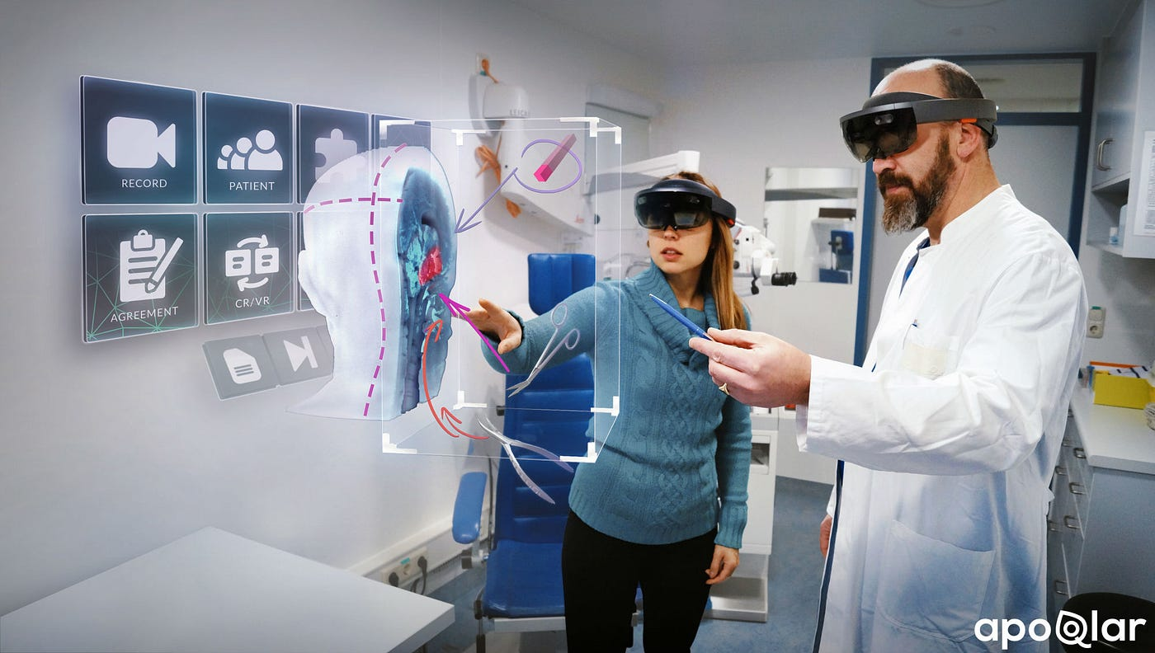
2. Healthcare
LEARN MORE

Slide 83
3. In-Store Shopping Experience
AR in-store shopping experiences enhance customer engagement, interactivity, and personalization. By leveraging virtual try-on, product visualization, interactive information, navigation assistance, and gamification, retailers can create unique and memorable shopping experiences that bridge the gap between the physical and digital realms, ultimately improving customer satisfaction and driving sales.
LEARN MORE

Slide 84
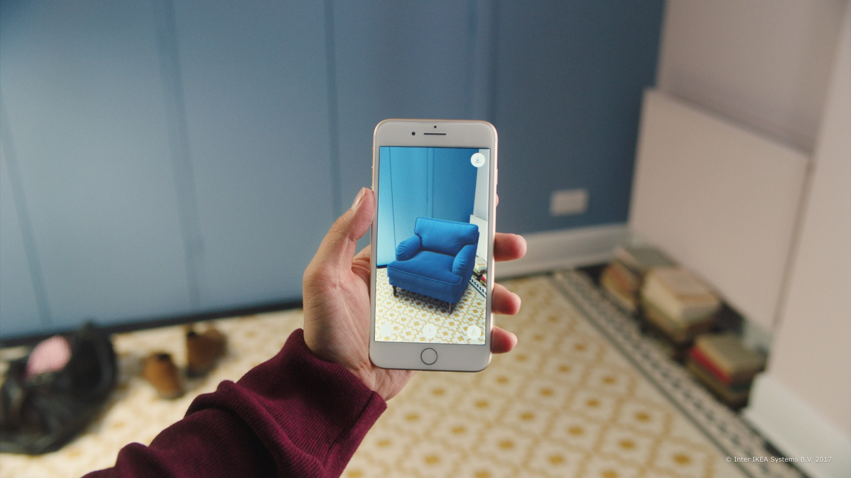
3. In-Store Shopping Experience
LEARN MORE

Slide 85
4. Logistics
Augmented Reality (AR) has the potential to revolutionize logistics operations by improving efficiency, accuracy, and productivity. Here are some examples of how AR is being used in the logistics industry:
-Warehouse Management
-Order Picking and Fulfillment
-Inventory Management
LEARN MORE

Slide 86
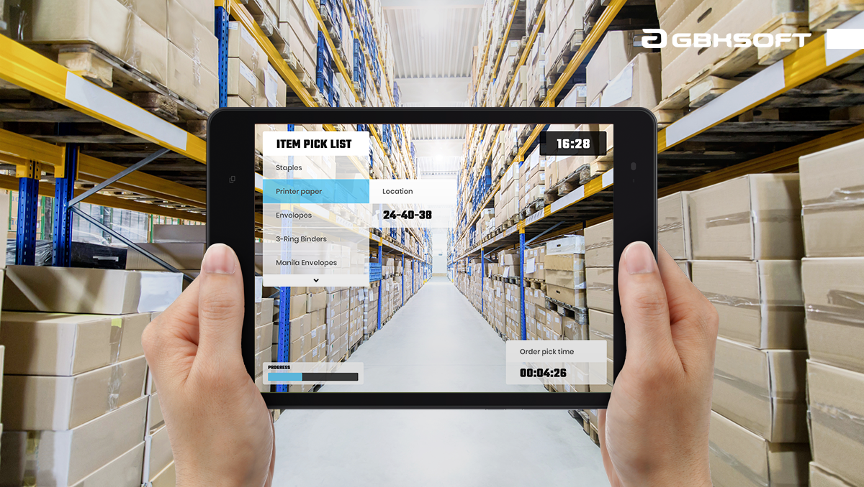
4. Logistics
LEARN MORE

Slide 87
5. Athletics
AR in athletics offers opportunities for enhanced training, performance analysis, fan engagement, and injury rehabilitation. By leveraging virtual coaching, interactive experiences, and real-time data visualization, AR technology contributes to improving athlete performance, fan enjoyment, and the overall experience of sports.
LEARN MORE

Slide 88
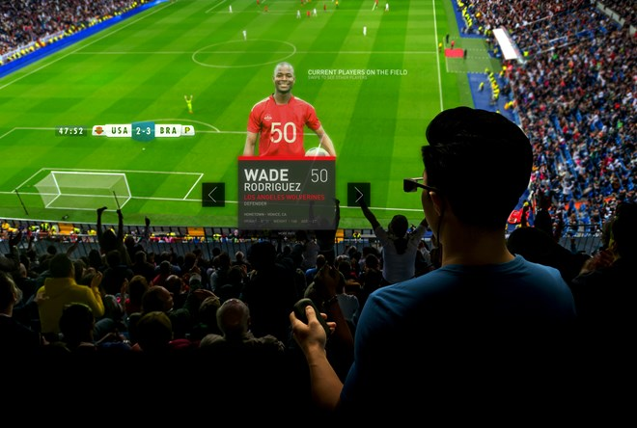
5. Athletics
LEARN MORE

Slide 89
6. Advertising
AR advertising, or Augmented Reality advertising, refers to the use of augmented reality technology in promotional and marketing campaigns to create interactive and immersive experiences for consumers. It allows brands to engage with their target audience in new and creative ways, leveraging the capabilities of AR technology to deliver memorable and engaging advertising content.
LEARN MORE

Slide 90
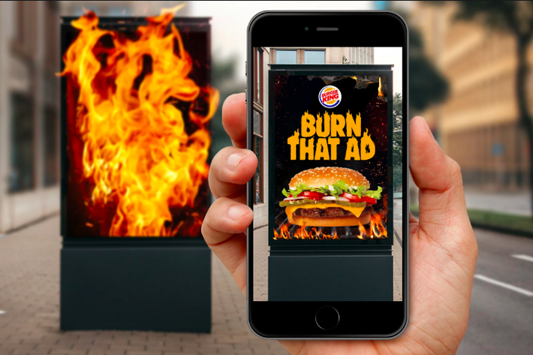
6. Advertising
LEARN MORE

Slide 91
7. Remote Collaboration
AR remote collaboration refers to the use of Augmented Reality technology to facilitate collaboration and communication among remote teams or individuals in different locations. It enables people to work together virtually, share information, and collaborate on projects as if they were in the same physical space.
LEARN MORE

Slide 92
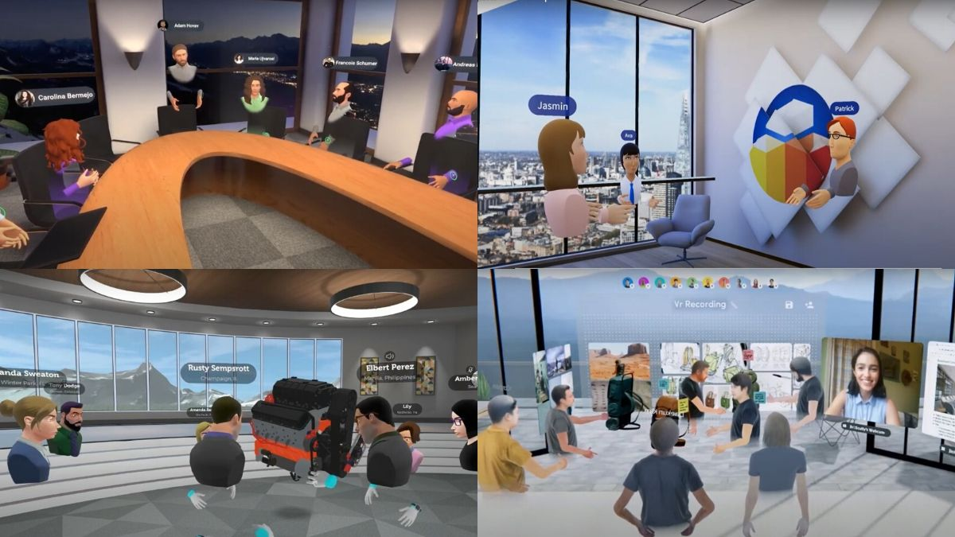
7. Remote Collaboration
LEARN MORE

Slide 93
8. Live Language Translation
AR live language translation refers to the use of Augmented Reality technology to provide real-time translation of spoken or written language, overlaying translated text or audio onto the user's view of the physical world. It enables users to understand and communicate with people who speak different languages, facilitating cross-cultural communication and breaking down language barriers.
LEARN MORE

Slide 94
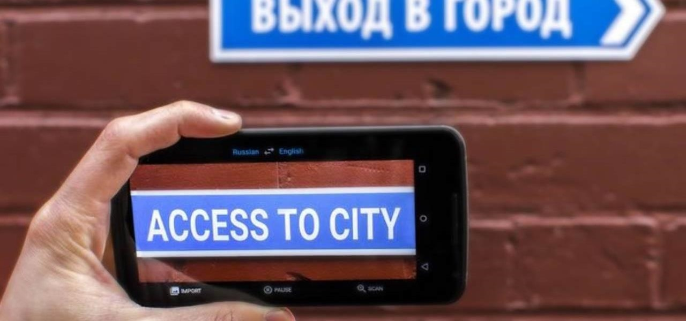
8. Live Language Translation
LEARN MORE

Slide 95
9. Gaming
AR gaming, or Augmented Reality gaming, refers to the use of augmented reality technology to create interactive and immersive gaming experiences that blend virtual elements with the real world. In AR games, players can interact with virtual objects, characters, and environments overlaid onto their physical surroundings, enhancing their gaming experience.
LEARN MORE

Slide 96
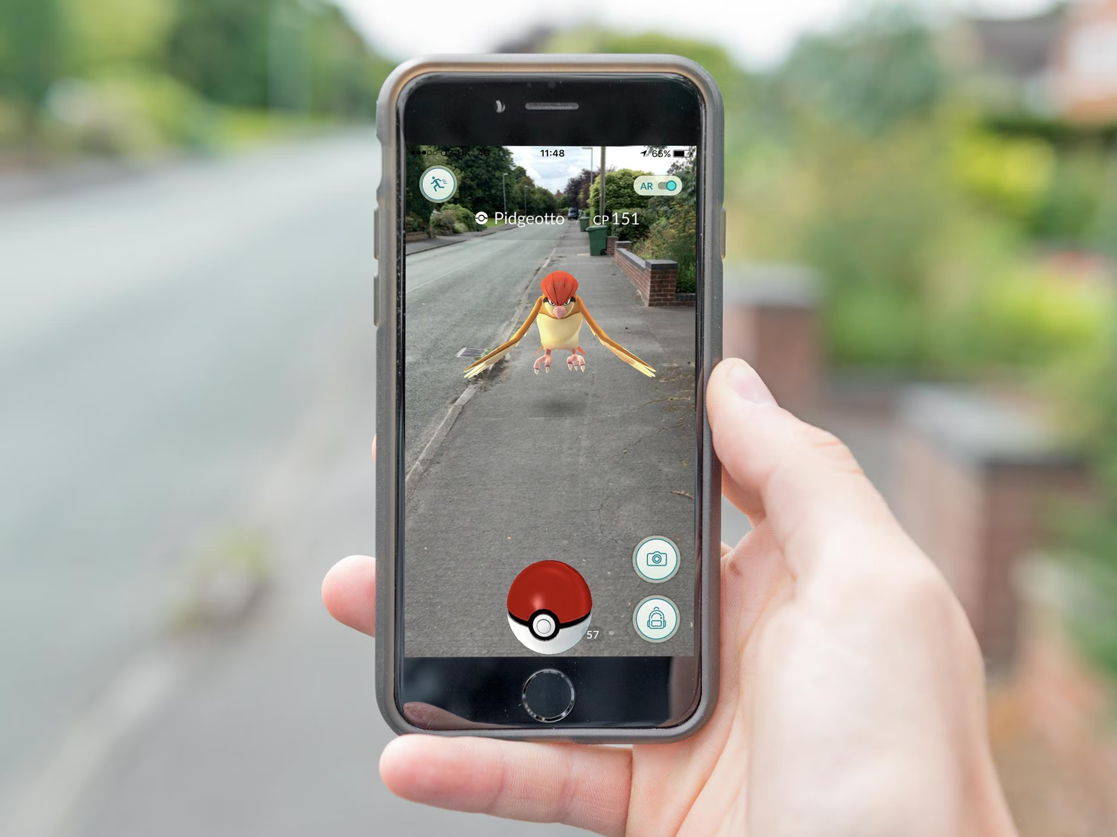
9. Gaming
LEARN MORE

Slide 97
10. Education
AR education, or Augmented Reality education, refers to the integration of augmented reality technology into educational settings to enhance the learning experience and provide interactive and immersive learning opportunities. AR enables students to engage with virtual content overlaid onto the real world, creating dynamic and interactive educational experiences.
LEARN MORE

Slide 98
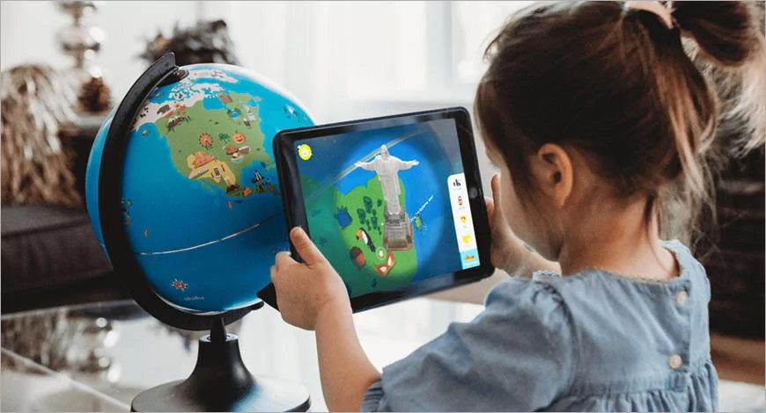
10. Education
LEARN MORE

Slide 99
11. Architecture and Design
AR (Augmented Reality) is playing a significant role in architecture and design by providing innovative tools and visualization capabilities that enhance the design process, communication with clients, and the overall user experience.
LEARN MORE

Slide 100
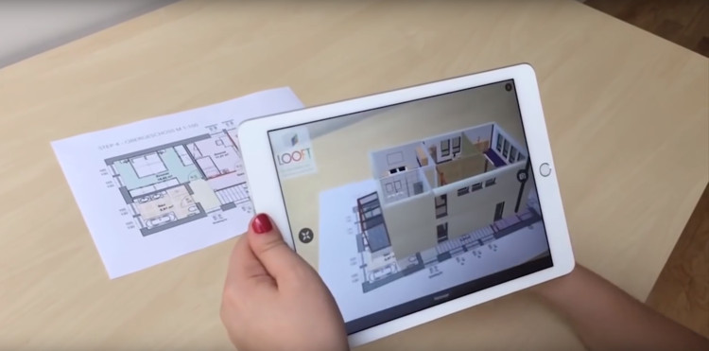
11. Architecture and Design
LEARN MORE

Slide 101
12. Aerospace and Defense
AR (Augmented Reality) technology is finding applications in the aerospace and defense industries, enhancing training, maintenance, and situational awareness
LEARN MORE

Slide 102
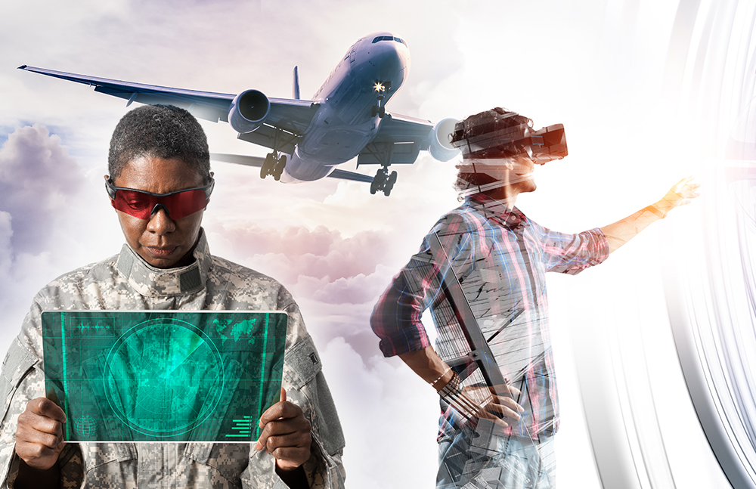
12. Aerospace and Defense
LEARN MORE

Slide 103
CHALLENGES
AND
FUTURE DIRECTIONS

Slide 104
TECHNICAL CHALLENGES
They have many fields to use AR technology and adequate financial resources to invest in. To name a few, here are some projects for which they can use AR:
Visualization of hidden infrastructure
Checking discrepancy
Proof of concept for construction projects
Maintenance instructions
Monitoring construction progress
LEARN MORE

Slide 105
TECHNICAL CHALLENGES
1. Lack of Proven Business Models
To name a few, here are some projects for which they can use AR:
Visualization of hidden infrastructure
Checking discrepancy
Proof of concept for construction projects
Maintenance instructions
Monitoring construction progress
LEARN MORE

Slide 106
TECHNICAL CHALLENGES
2. Lack Of Standards For AR App Design & Development
It is essential to have standards as it is like a universal language. It sets parameters that work on a universal level when developing a software application or planning a marketing campaign. It helps guarantee contribution and compatibility to the entire technology development. And this is something that is still under progress for augmented reality.
LEARN MORE

Slide 107
TECHNICAL CHALLENGES
3.Security & Privacy Issues with Augmented Reality
One of the significant challenges that the AR industry has to face is security and privacy concerns. There is a legitimate chance you can get into trouble without intending to do so because of the inconsistencies in the AR programming, negligence, and oversight
LEARN MORE

Slide 108
USER EXPERIENCE

Slide 109
5 KEY UI UX PILLARS FOR AUGMENTED REALITY DESIGN
Environment:
Movement:.
Onboarding:
Interaction:
Feedback:
.­

Slide 110
ETHICAL AND PRIVACY CONSIDERATIONS

Slide 111
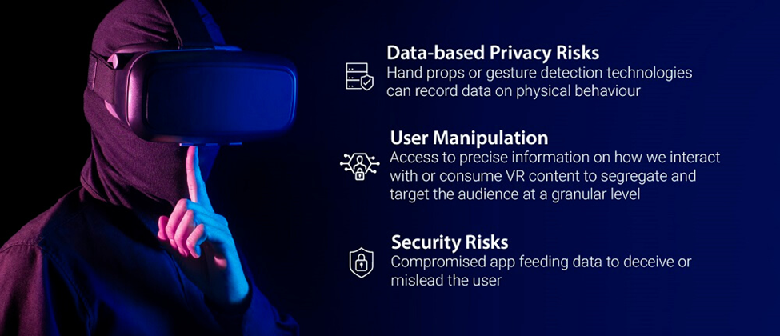
ETHICAL CONSIDERATIONS
ETHICAL CONSIDERATIONS

Slide 112
FUTURE
PROSPECT

Slide 113
In terms of potential, augmented reality is the next version of the internet
Sectors such as entertainment, healthcare and retail are predicted to integrate the technology the quickest. But challenges such as consumer adoption, technical skill and ethical concerns remain
LEARN MORE

Slide 114
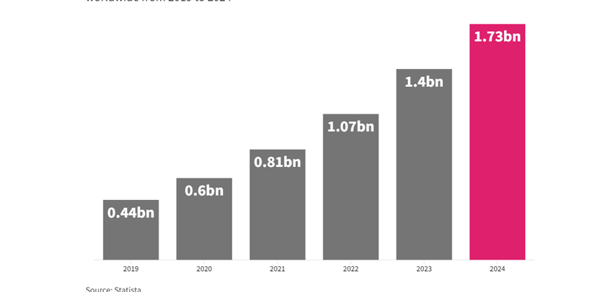
There will be an estimated 1.73bn active AR user devices by 2024
LEARN MORE

Slide 115
EXAMPLES AND SUCCESS STORIES OF AR IMPLEMENTATIONS

Slide 116

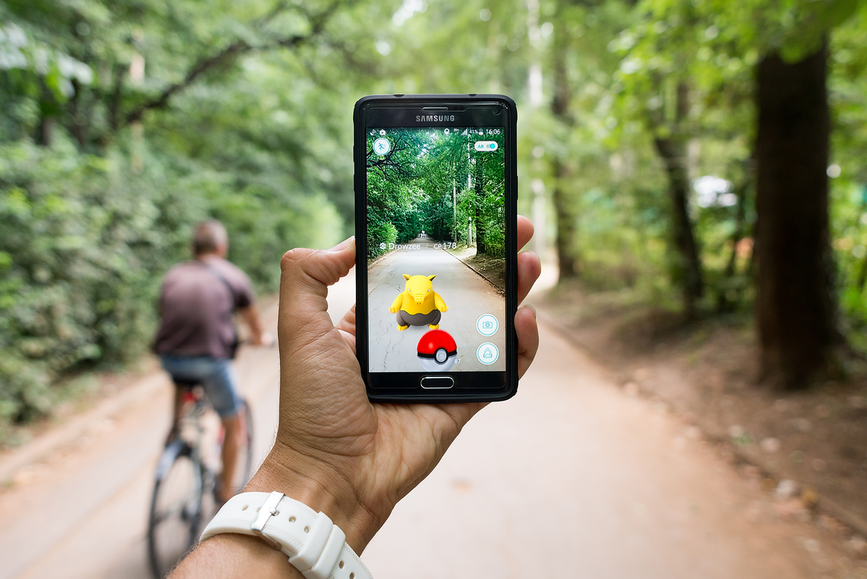
1.) Pokémon Go
The game combines GPS technology and location-based augmented reality to let players capture virtual Pokémon characters in actual places.

Slide 117

2.) Snapchat Filters
The "Lenses," or augmented reality filters, introduced by Snapchat have had a big impact on self-expression and social networking. Users can add interactive and dynamic effects to their faces or the background of their images and videos to add fun and creativity.

Slide 118


3.) IKEA Place
IKEA Place is an AR app that allows users to virtually place furniture and home decor items in their own spaces. By leveraging AR technology, users can see how items would look and fit in their homes before making a purchase.

Slide 119

4.) Snapchat Landmarkers
The "Landmarkers" tool that Snapchat introduced lets users add augmented reality effects to well-known structures and landmarks.

Slide 120


Slide 121


5.) Microsoft HoloLens
Microsoft HoloLens is a mixed reality headset developed and produced by Microsoft. It was first announced in January 2015 and has since undergone several iterations, with the latest version being the HoloLens 2, released in 2019.

Slide 122


6.) Way Finding and Navigations
The use of augmented reality (AR) has improved navigational experiences and provided real-time information in a variety of wayfinding and navigation applications.

Slide 123


7.) Medical Training and Visualization
In the medical industry, AR has been widely used for teaching and visualization reasons. During operations, surgeons can overlay real-time patient data, anatomical features, and instructions using augmented reality (AR) headsets or smart glasses, improving precision and lowering risks

Slide 124

STUDIO SHODWE
THANK YOU
2023 PRESENTATION

